Slide 1













DIGITAL PORTFOLIO
STUDENT NAME:SWATHI.N
REGISTER NUMBER:222406278
NMID:CCB54CED8E5466894D34258004D7EFB8
DEPARTMENT:BSC COMPUTER SCIENCE WITH ARTIFICIAL INTELLIGENT
COLLEGE: SRM ARTS AND SCIENCE COLLEGE
UNIVERSITY: MADRAS UNIVERSITY

Slide 2
PROJECT TITLE
Here’s a structured MS PowerPoint presentation content outline for the topic “Online Portfolio Website for Freelancers” with suggested text + image ideas slide by slide. You can directly copy this into PowerPoint and add matching visuals.

Slide 3
AGENDA
1.problem statement
2.project overview
3.endusers
4.tools aand technology
5.portfolio design and Layout
6.featured and functionality
7.results aand screen shots
8.conclusion
9.github link

Slide 4
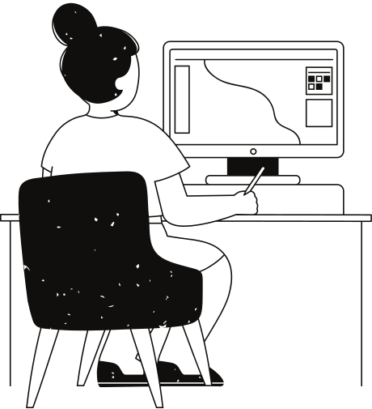
Problem Statement
In today’s competitive world, having a strong online presence is essential for students and professionals. Many individuals struggle to showcase their skills, achievements, and projects in a structured way. Traditional resumes fail to demonstrate creativity and technical abilities effectively. This project aims to solve that problem by creating a digital portfolio websit
e.

Slide 5
Project Overview
The portfolio project is a responsive, user-friendly website that highlights personal details, academic background, skills, projects, and achievements. It serves as a digital resume to present information in an attractive and interactive manner. The platform is designed to be customizable so users can update their details easily

Slide 6
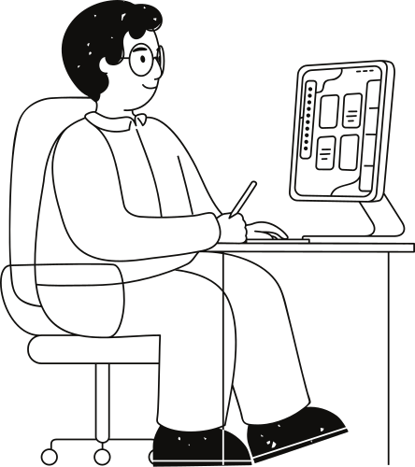
End Users
Students – to display academic achievements and projects.
Job Seekers – to highlight skills and professional experience.
Freelancers – to showcase work samples and attract clients.
Professionals – to maintain a digital identity and career profile.

Slide 7
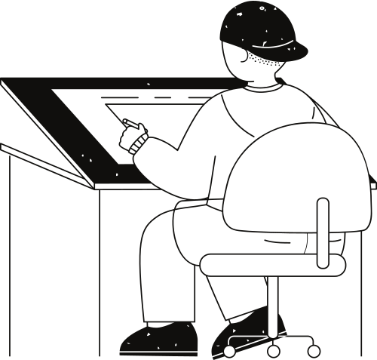
Tools and Technologies
Frontend: HTML, CSS, JavaScript, React
Backend (if included): Node.js, Express.js
Database (if included): MongoDB / MySQL
Version Control: Git & GitHub
Design Tools: Figma / Canva for layout planning

Slide 8
Features and Functionality
Responsive design (works on mobile, tablet, and desktop)
Interactive navigation bar
Contact form with email integration
Project showcase with links to GitHub/Live Demo
Dark mode toggle (optional)
Easy content update through code or CMS

Slide 9
Results and Screenshots
The developed portfolio successfully displays all required information in a structured manner. Screenshots of the working website demonstrate:
Responsive UI on multiple devices
Smooth navigation between sections
Clear presentation of skills and projects

Slide 10
Conclusion
The portfolio website effectively addresses the problem of limited self-representation in traditional resumes. It provides a professional, interactive, and accessible platform for showcasing personal and professional details. This project highlights both technical skills and creativity, making it a valuable tool for career growth.

Slide 11

GitHub Link
The complete source code of this portfolio is available on GitHub for reference, collaboration, and future improvements.Add a subheading

Slide 12
Thank you very much!

